Slide 1
Recommender Systems

Slide 2
Personalization
“If I have 3 million customers on the Web, I should have 3 million stores on the Web.”
—Jeff Bezos, CEO of Amazon.com (1998)
500
450
448
80
70
67
68
400
63
350
60
300
50
46
47
50
267
39
43
250
40
35
200
30
24
29
29
161
18
21
150
20
16
100
94
10
10
40
64
1
1
1
4
50
5
6
7
19
0
0
0.8
1995
1996
1997
1998
1999
2000
2001
2002
2003
2004
2005
2006
2007
2008
2009
2010
2011
2012
2013
2014
1999
2000
2001
2002
2003
2004
2005
2006
2007
2008
2009
Number of retail categories
Number of unique items in catalog (millions)
source: http://phx.corporate-ir.net/phoenix.zhtml?c=176060&p=irol-mediahome

Slide 5
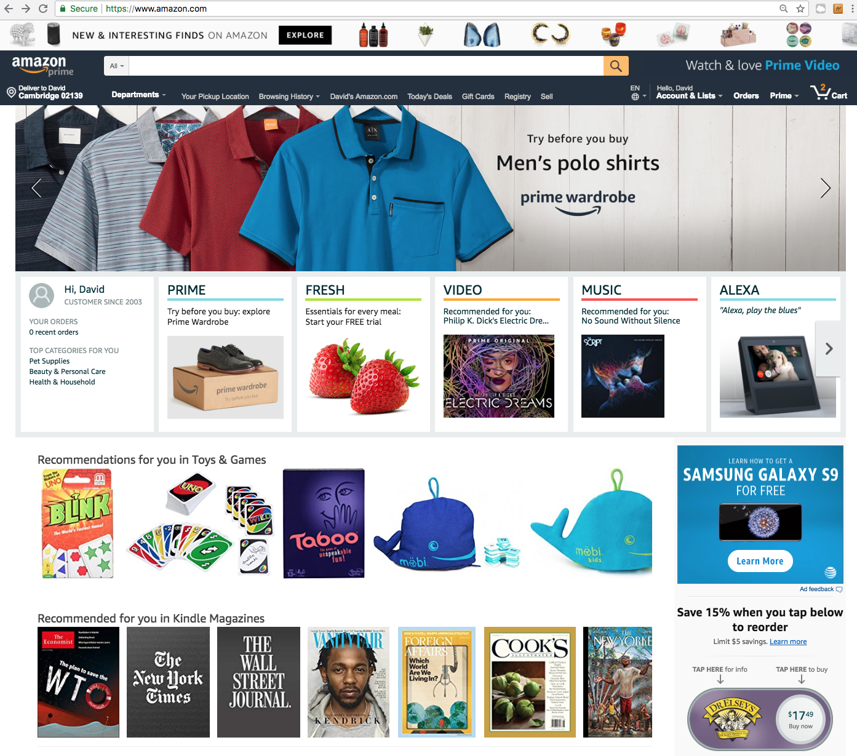
My Personalized Store
source: amazon.com

Slide 6
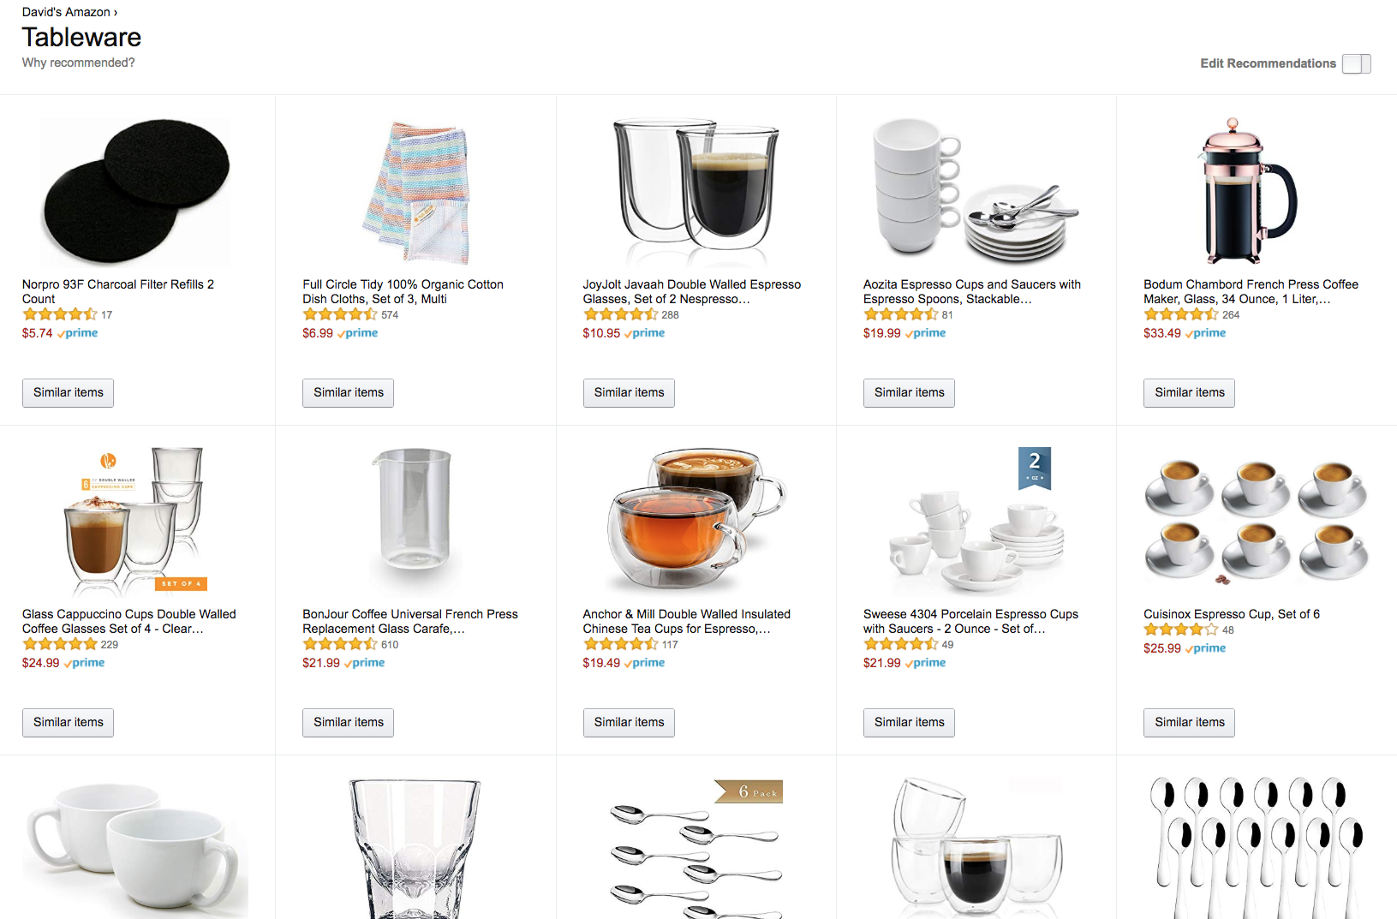
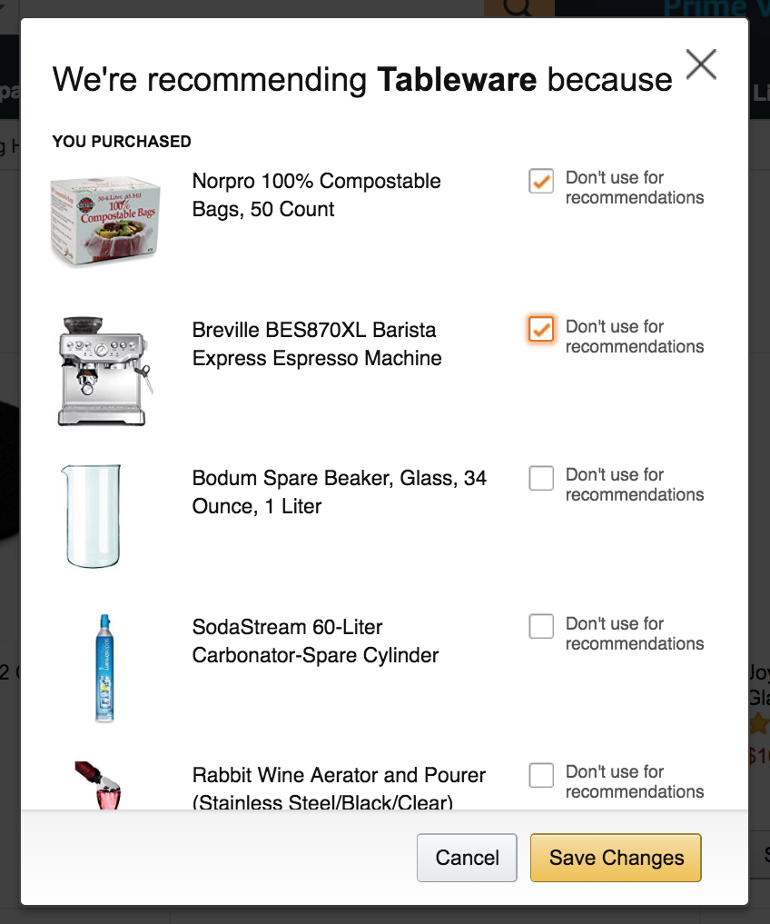
Personalized Merchandising
Why do you think it is helpful to explain to customers why a recommendation is made, and to let them
source: amazon.com
Q

Slide 9
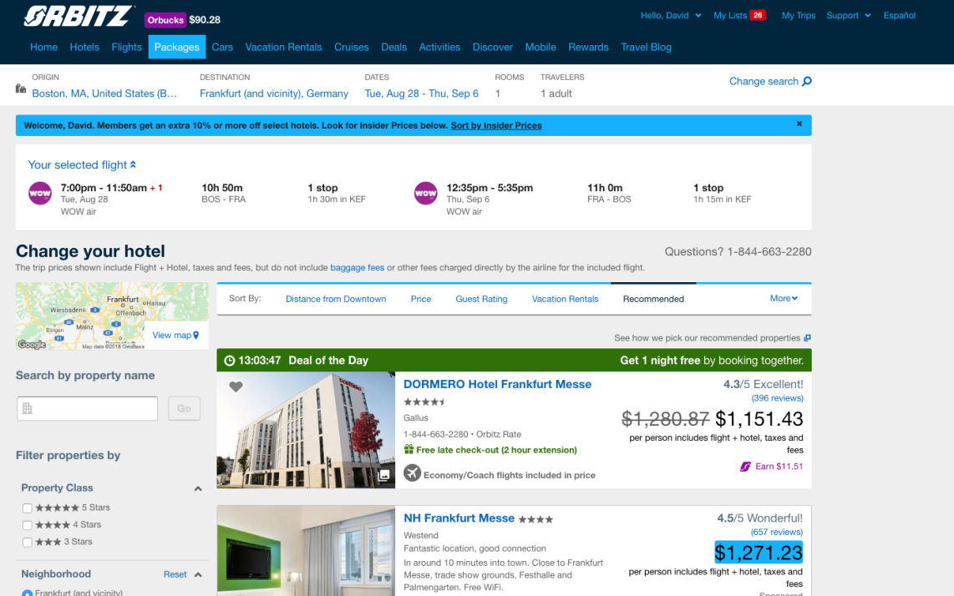

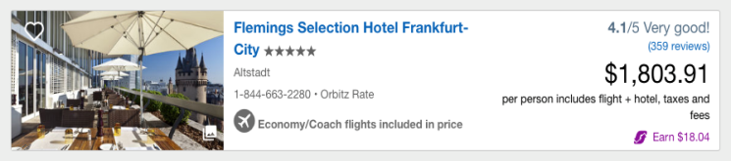

Cross-Selling
Hotel Recommendations
“location, review scores, popularity (…bookings), … quality of the content… competitiveness of [] rates and availability … compensation which a property pays us [] is also a factor for the relative ranking of properties with similar offers”
Recommendations
source: Orbitz

Slide 10
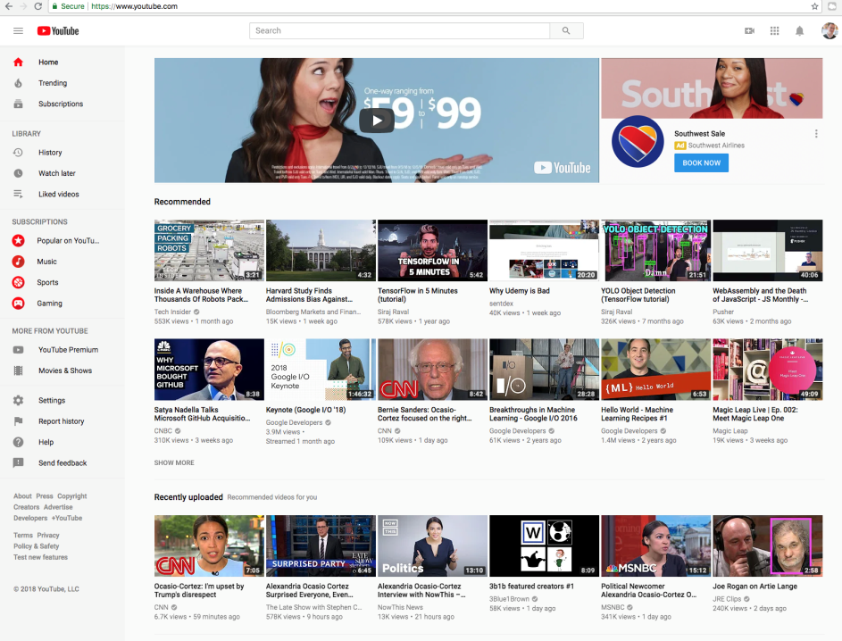
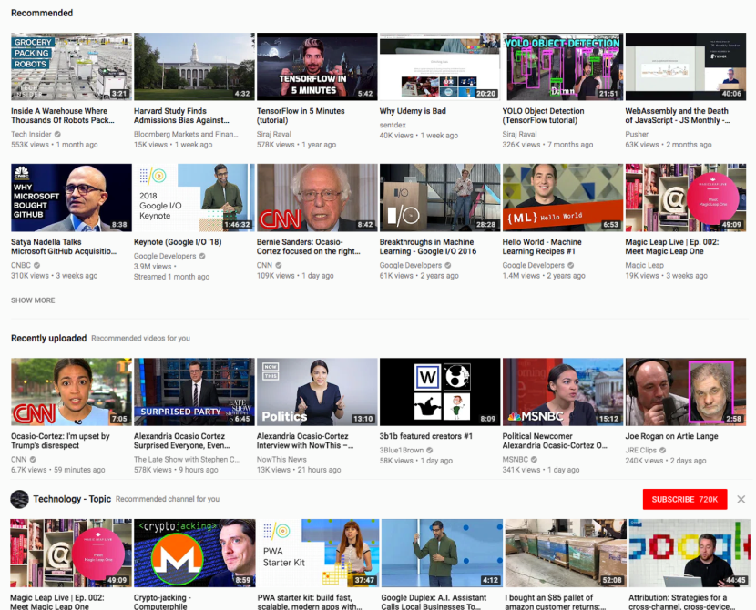
Video Recommendations
source: YouTube

Slide 11

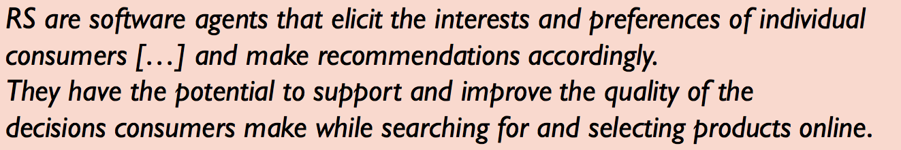
Guided Discovery
Recommendations
Items
products, web sites, people, news, jobs, …
Search
source: Xiao and Benbasat’07, Jannach, 2014, Mining of Massive Datasets, http://www.mmds.org
Q

Slide 14
The Value of Recommendations
For consumers
For businesses
Better, faster decisions
Serendipitous discovery
Access to long-tail of products, services, information
Learn about the quality judgments of others
Enjoyment
Cross-sell, up-sell; market to the long-tail
Develop stronger relationship with customers
Improve customer satisfaction, retention
Data as an asset!

Slide 16
Collaborative Filtering

Slide 17
Types of Recommendations
Editorial and hand curated
List of favorites
Lists of “break out” items
Simple aggregates
Top 10, most popular, recent uploads
Tailored to individual users
Amazon, Netflix, AdWords…

Slide 18



Recommender Systems
1
Collaborative: Tell me what’s popular among my peers.
User profile and contextual prameters
item | score
i1 | 0.9
i2 | 1
i3 | 0.3
… | …
Community data
Recommendation component
Recommendation list
source: Jannach, 2014

Slide 19
Recommender Systems
2
Content-based: Show me items with similar features to those I’ve liked.
User profile and contextual prameters
item | score
i1 | 0.9
i2 | 1
i3 | 0.3
… | …
Title | Genre | Actors | …
Recommendation component
Recommendation list
Product features
source: Jannach, 2014

Slide 20
Recommender Systems
3
Hybrid: Use combinations of various inputs and different methods.
User profile and contextual prameters
item | score
i1 | 0.9
i2 | 1
i3 | 0.3
… | …
Community data
Title | Genre | Actors | …
Recommendation component
Recommendation list
Product features
source: Jannach, 2014

Slide 21








Collaborative Filtering
Does user 3 like oranges?
User 1
User 2
User 3
Purchases
source: https://medium.com/@tomar. ankur287/item-item-collaborative-filtering-recommender-system-in-python-cf3c945fae1e

Slide 22
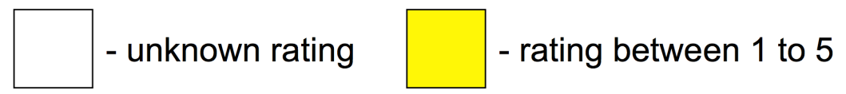
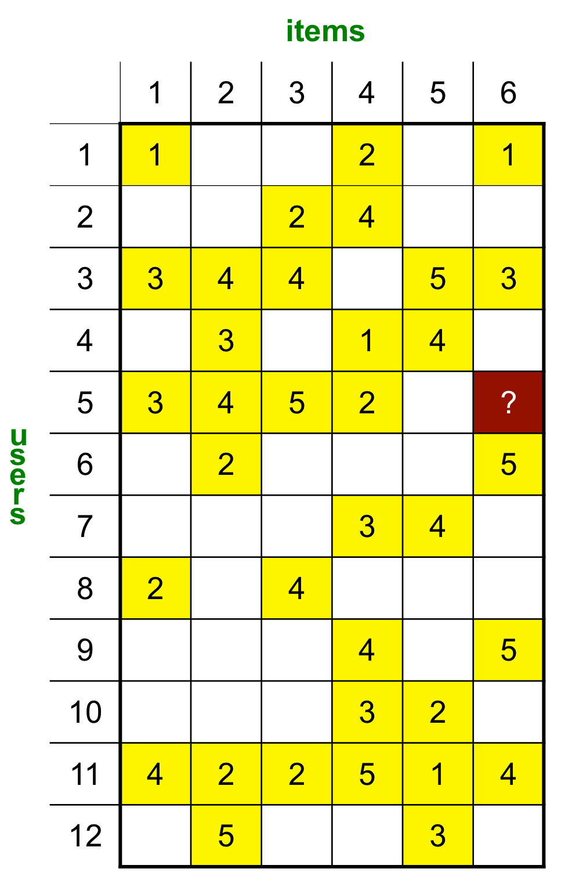
Collaborative Filtering
Data: implicit or explicit preference data on some user-item pairs
For example: ratings, purchases, views, click counts…
High level goal: predict missing entries
source: Mining of Massive Datasets, http://www.mmds.org

Slide 23
Collaborative Filtering
User–User:
Find users similar to user 5 (users 1, 3)
Average the rating on item 6 for these users
Item–Item:
Find items similar to item 6 (items 1, 4)
Average the rating of user 5 on these items
source: Mining of Massive Datasets, http://www.mmds.org
Q

Slide 26
Item-Item Collaborative Filtering
Items are simpler, users have multiple tastes
A user can like 60s rock and 1700s baroque, but an item is only one of these two genres
source: Mining of Massive Datasets, http://www.mmds.org

Slide 27

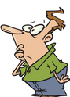
First step: Center Ratings
Mean (all movies) = 3.7
The Sixth Sense is 0.6 above mean
Joe is 0.2 below mean
Baseline b_{joe,6th} = 3.7+0.6–0.2 = 4.1
If Joe rates The Sixth Sense at 4, the centered rating is -0.1
source: Mining of Massive Datasets, http://www.mmds.org

Slide 28
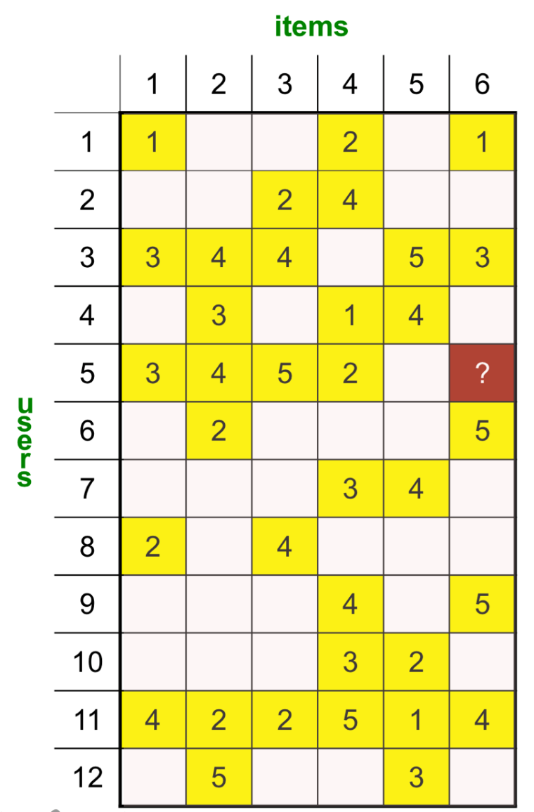
Item-Item Collaborative Filtering
1
Find k (e.g., k = 2) items most similar to item 6, of those rated by user 5
source: Mining of Massive Datasets, http://www.mmds.org

Slide 29
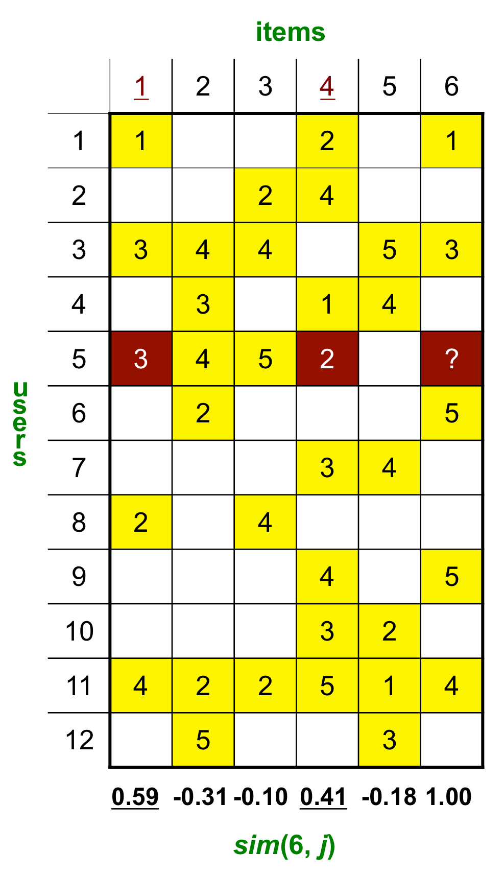
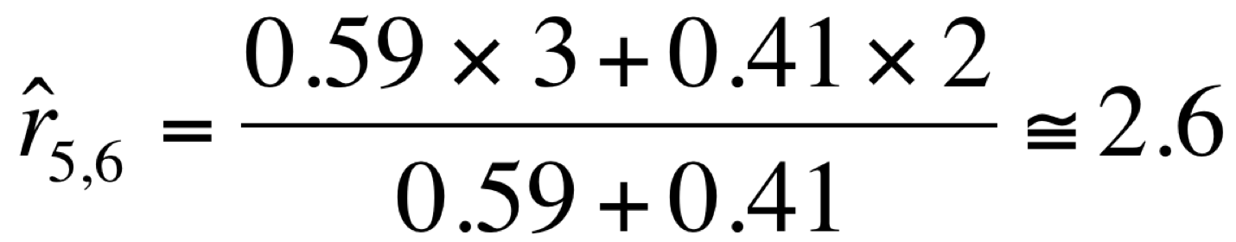
Item-Item Collaborative Filtering
1
Find k (e.g., k = 2) items most similar to item 6, of those rated by user 5
2
Predict (similarity-weighted average):
source: Mining of Massive Datasets, http://www.mmds.org

Slide 30
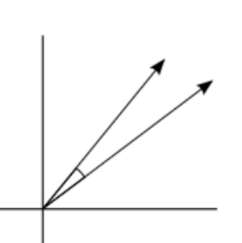

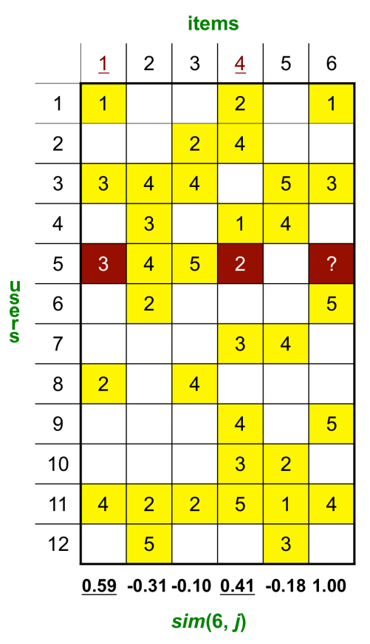
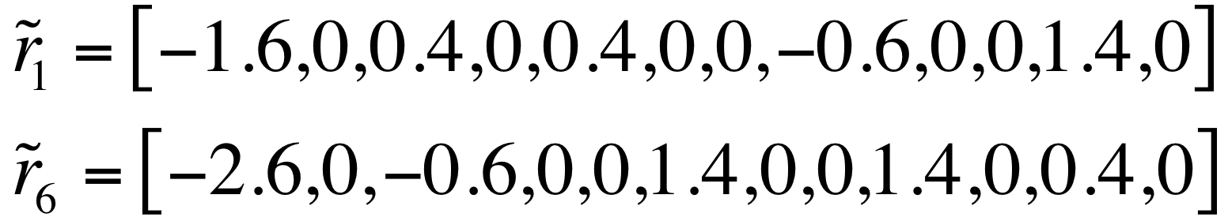
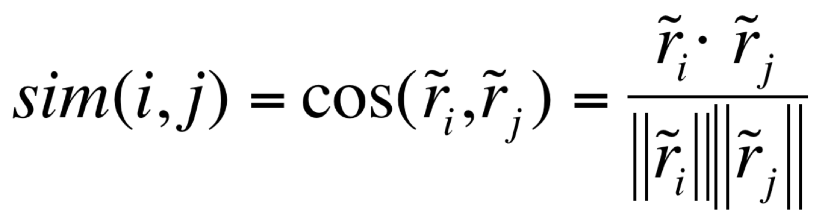

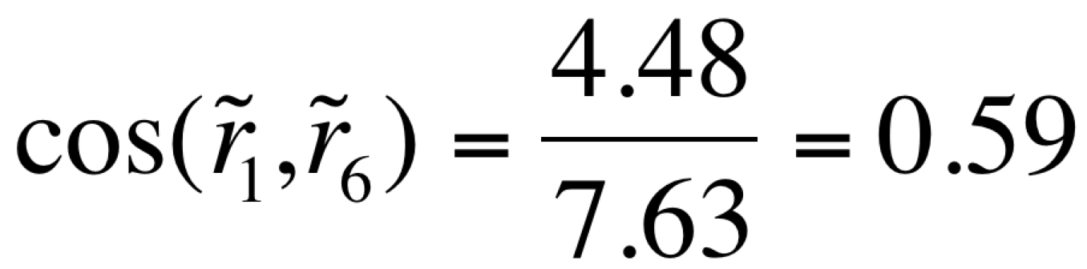
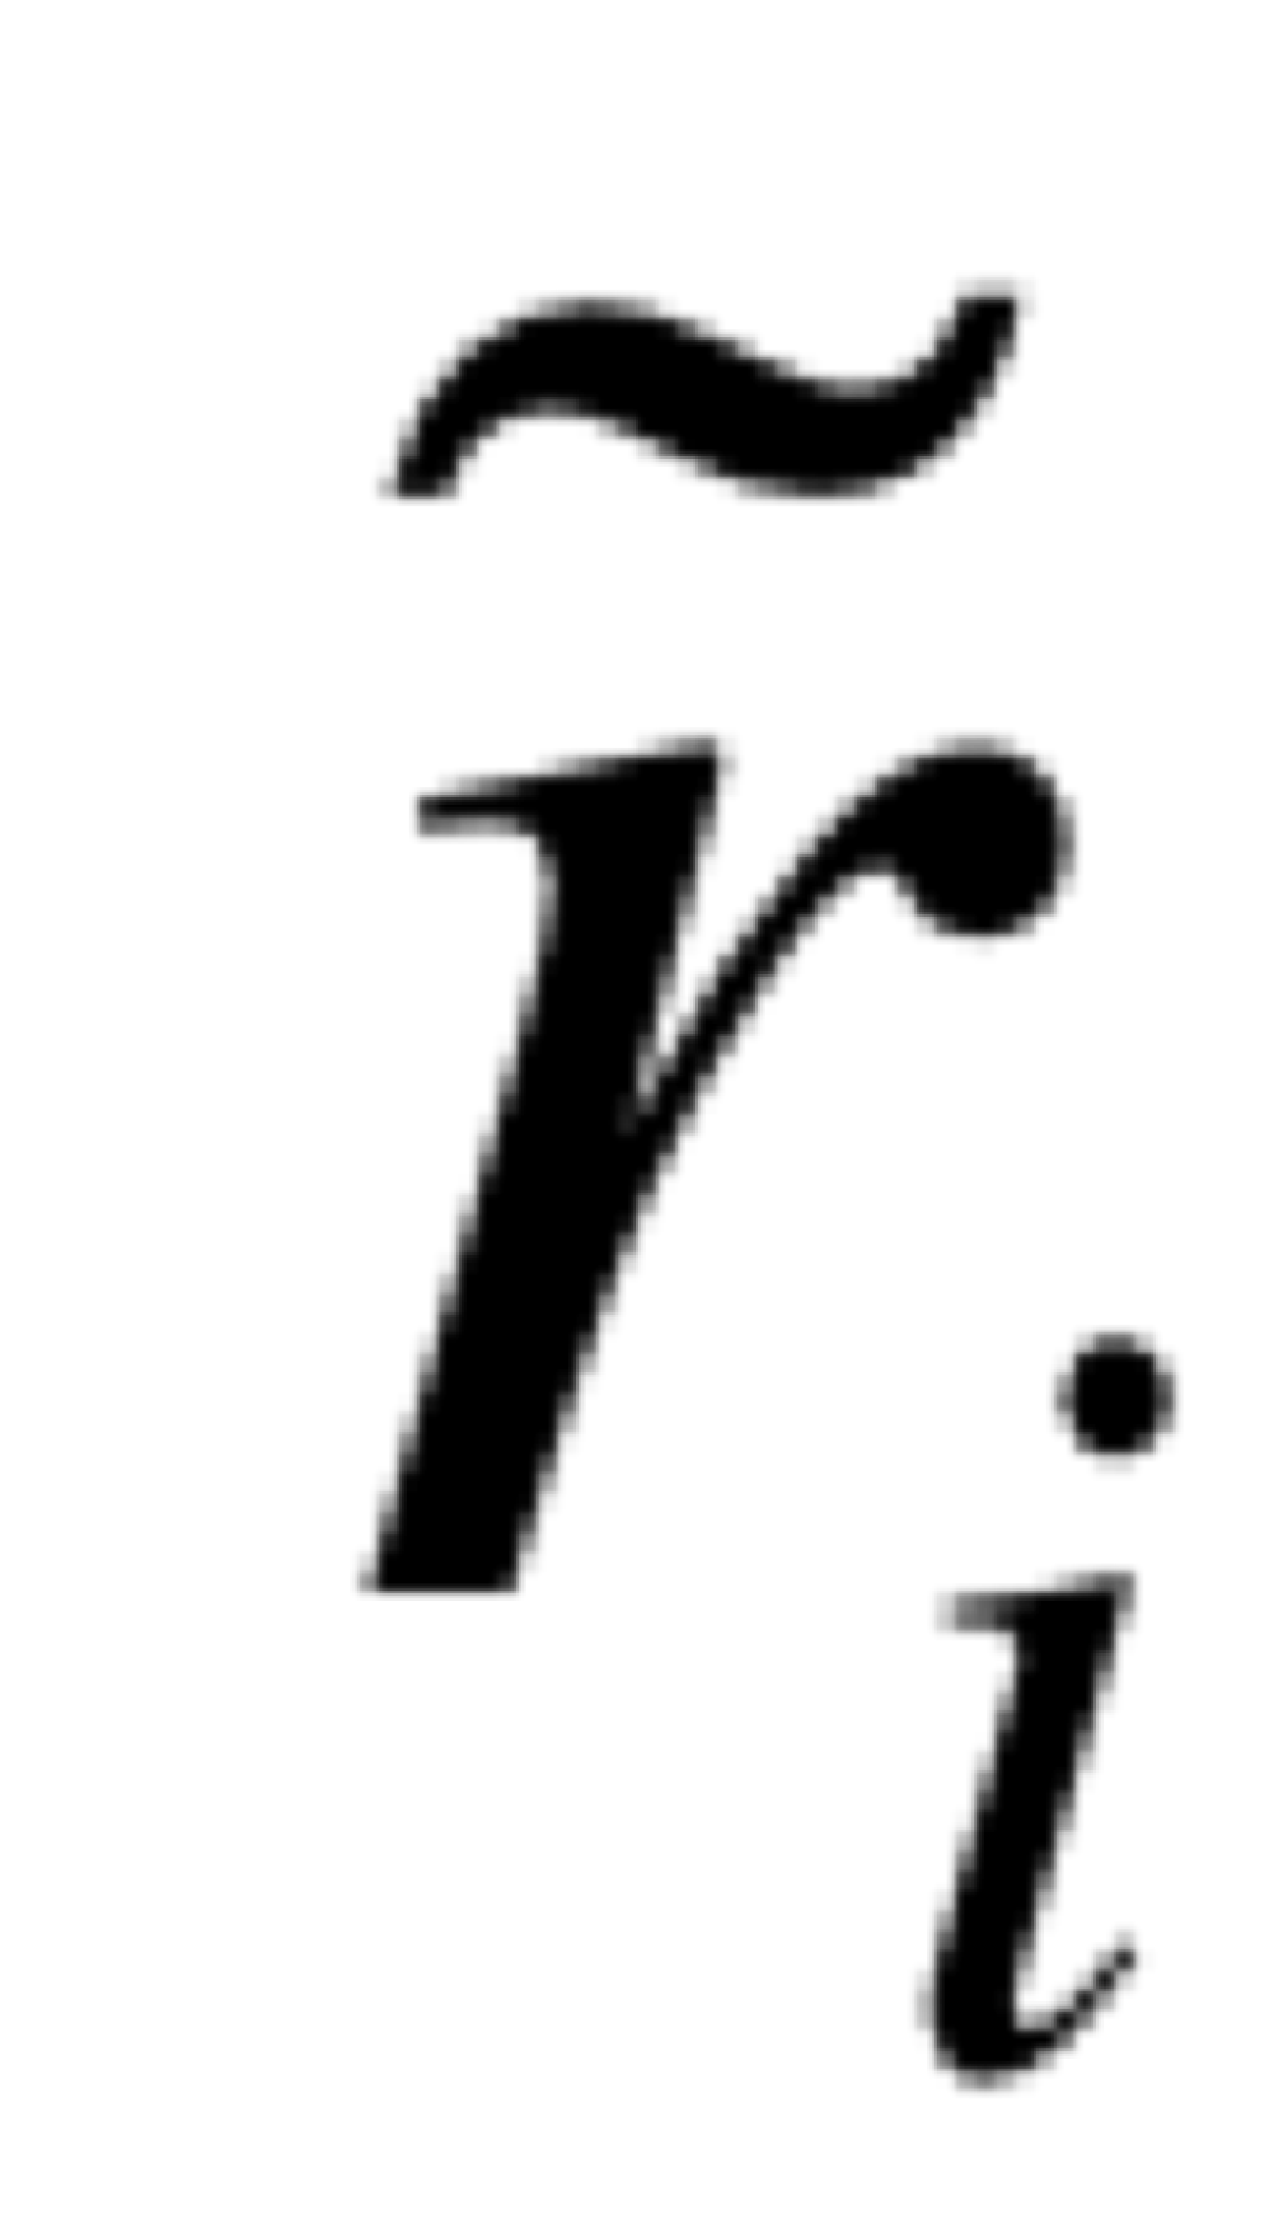

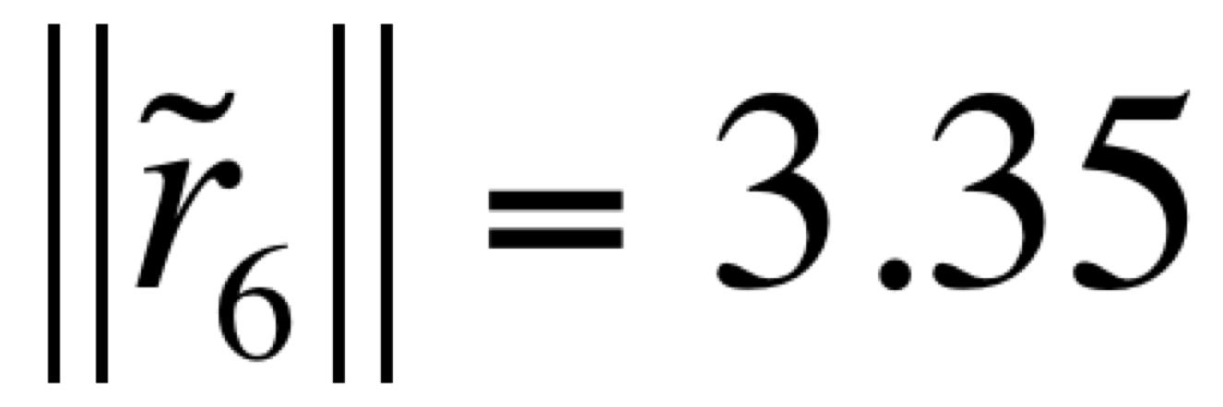
The Similarity Metric
Normalize ratings (for each item, subtract mean, set missing entries to zero), obtaining
1
Calculate
2
source: Mining of Massive Datasets, http://www.mmds.org;
http://blog.christianperone.com/2013/09/machine-learning-cosine-similarity-for-vector-space-models-part-iii/

Slide 32
The Netflix Prize

Slide 33
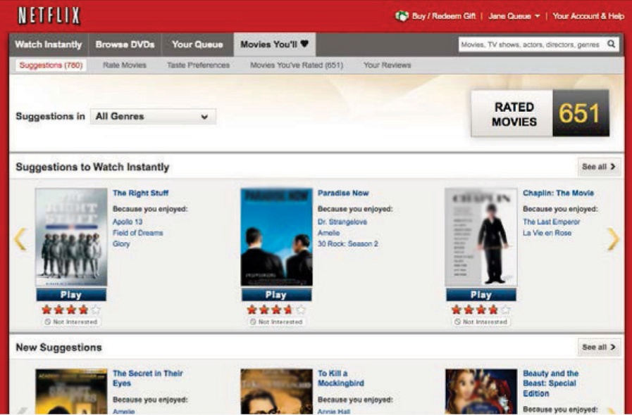
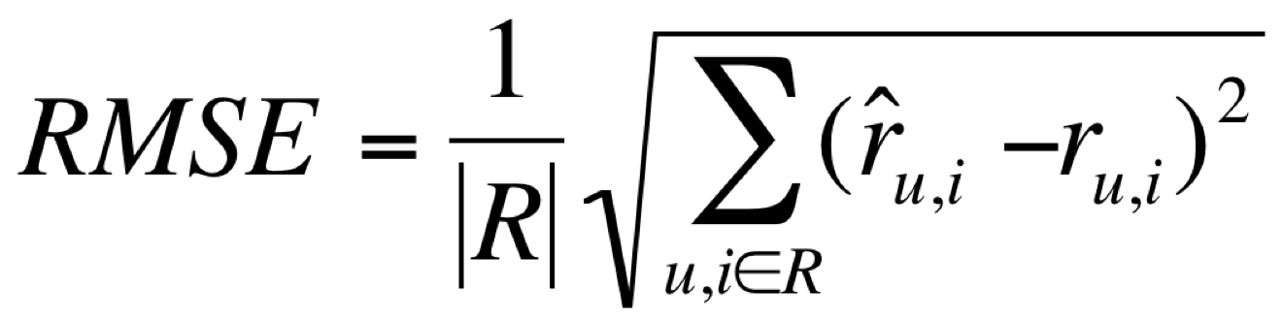
The Netflix Prize
October 2006: Netflix had 1.9 billion ratings, 11.7 million subscribers, 85,000 titles
Shipping 1.5 million DVDs a day
$1 million to improve RMSE by 10% (from 0.9514; item–item CF)
source: Netflix Investor Day presentation, May 2008
17,700 movies
1
3
4
3
5
5
4
5
5
Released 100 million ratings, 480,000 users, on 17,700 titles
Held back 1.5 million ratings
480,000 users
3
3
2
?
?
?
2
1
?
3
?
1
Training Data Set
Test Data Set

Slide 34


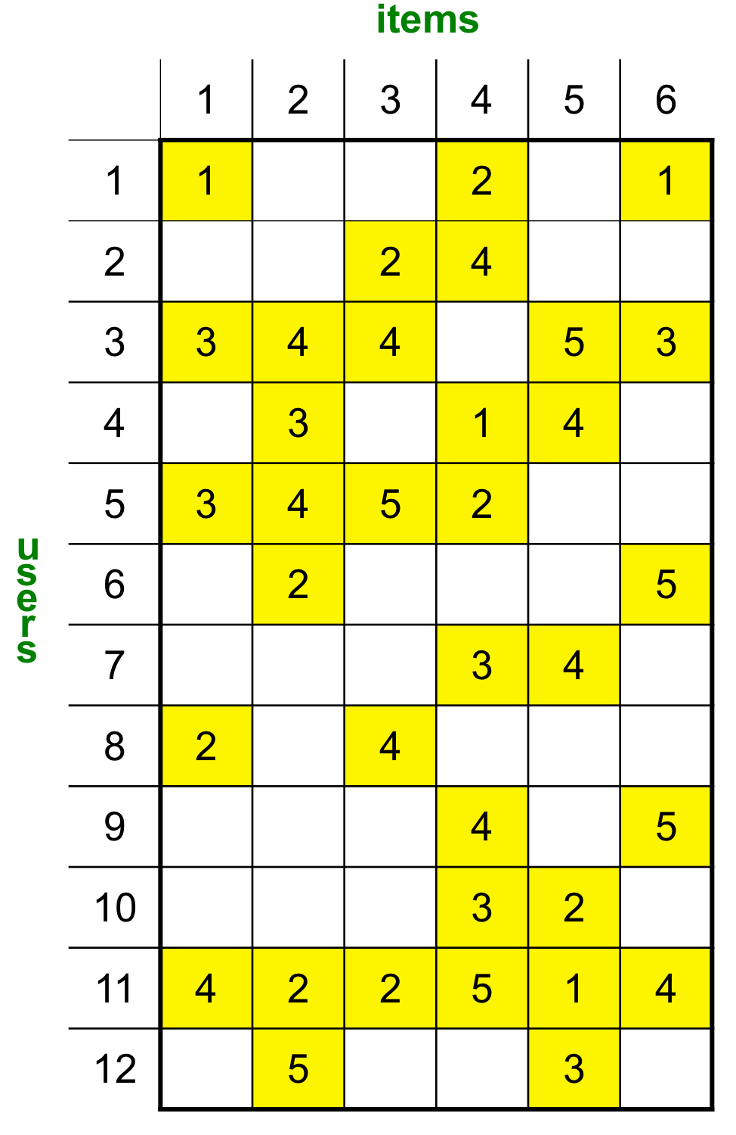

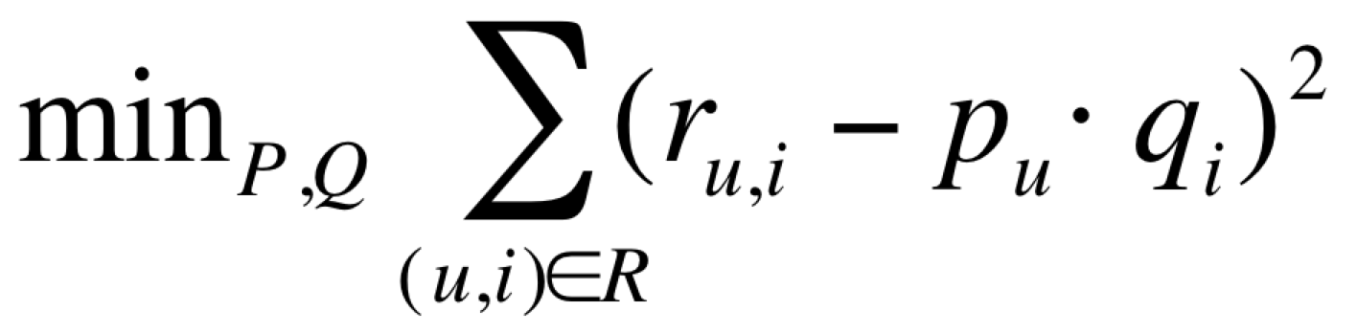
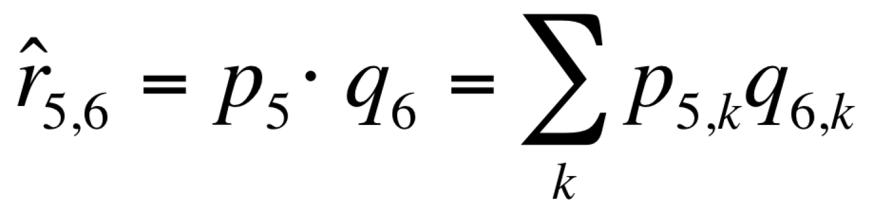
Matrix Factorization
Factors
Item matrix
×
Q
Factors
P
1
Factorize into (P,Q)
≈
(+ penalty, avoid over-fitting)
2
Calculate missing entries:
User matrix
source: Mining of Massive Datasets, http://www.mmds.org

Slide 35
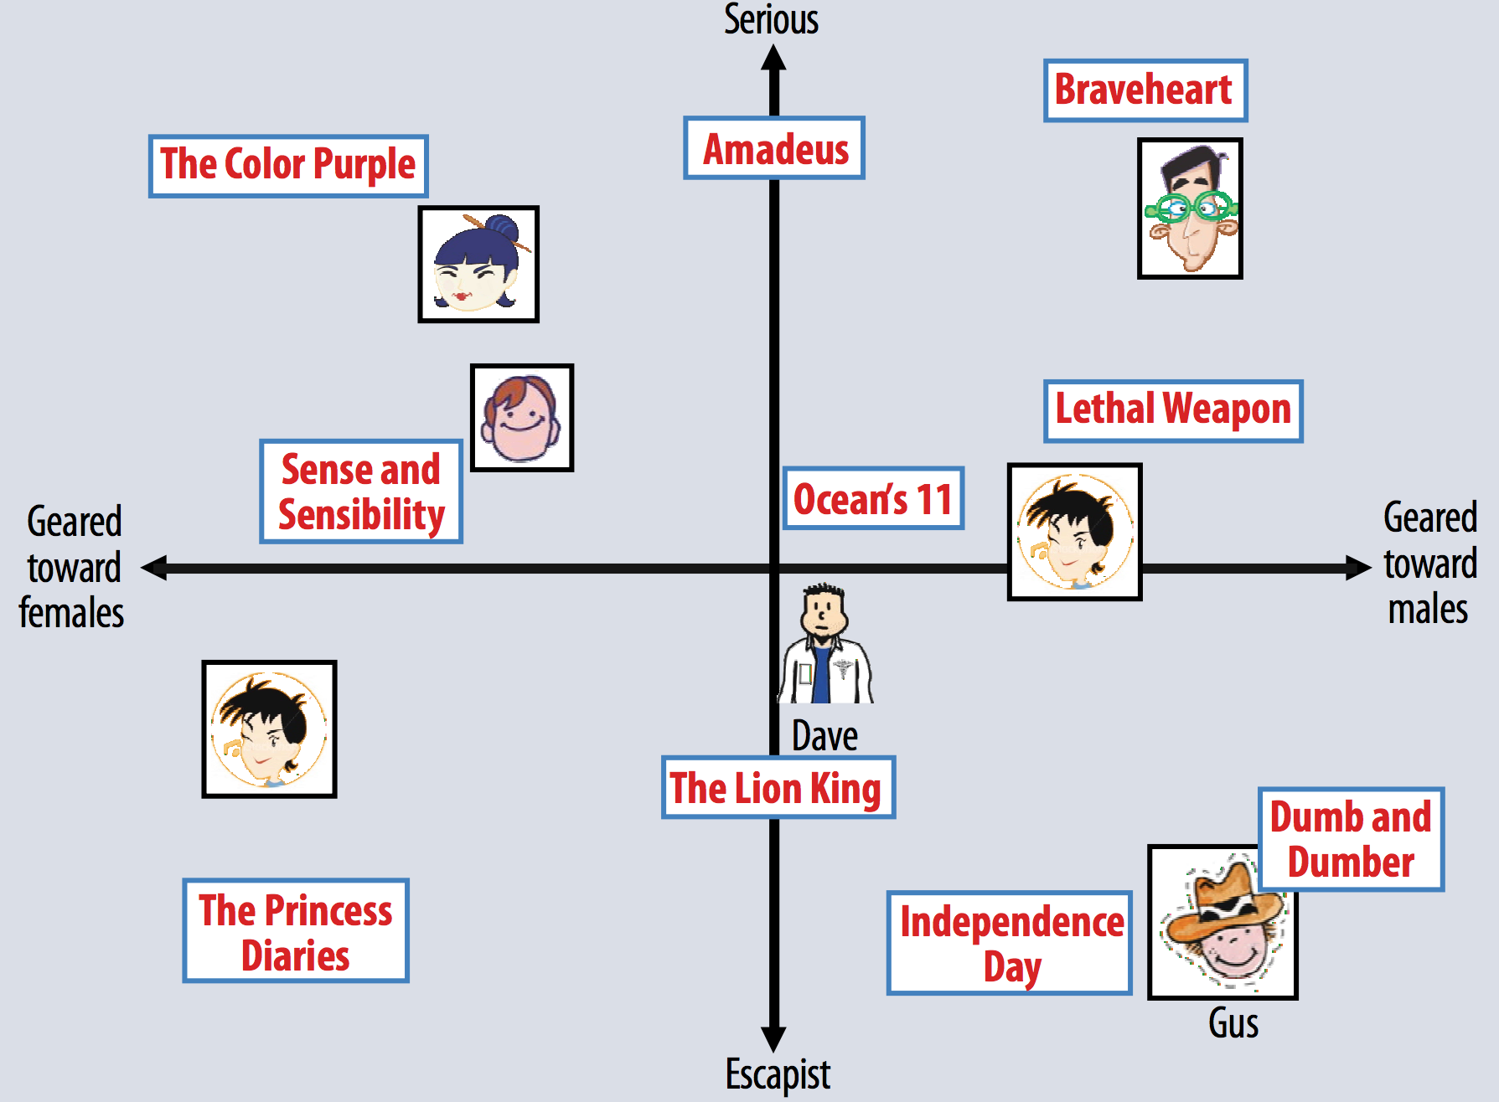
Illustrative: Factor Space
Factor 1
Factor 2
© 2009 IEEE. Reprinted, with permission, from Computer Magazine.

Slide 36

Netflix Progress Prize
Baseline: 0.9514 Prize: 0.8563
2007 “Progress Prize”: two models were deployed at Netflix
Item–Item CF (+learning)
Matrix Factorization (MF)
Item-Item CF + temporal bias
MF + temporal bias
source: Mining of Massive Datasets, http://www.mmds.org

Slide 37
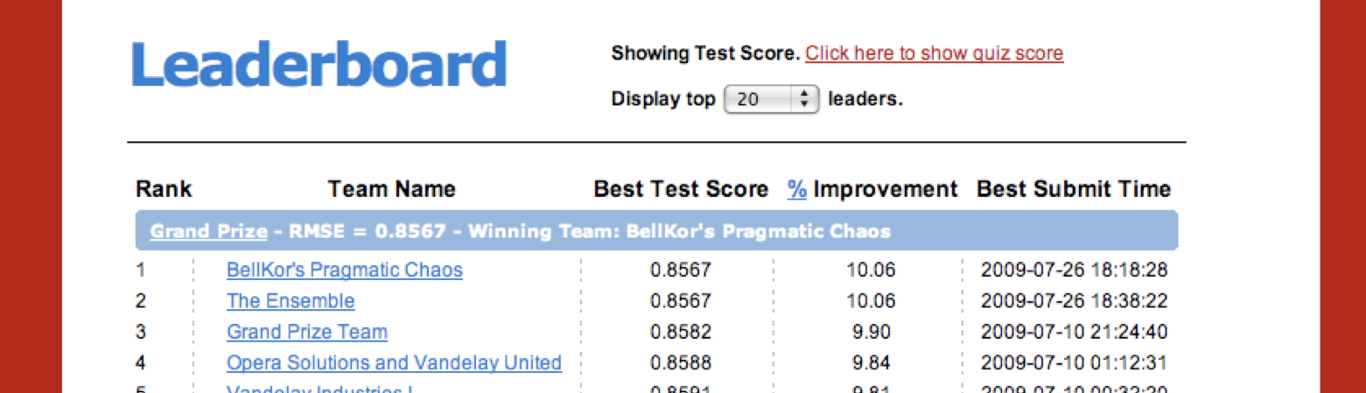
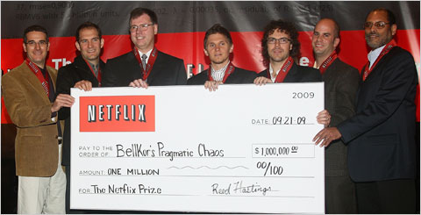
Breaking Through 10%
An “ensemble method” (train predictors sequentially)
0.8585
0.858
blend RMSE
Grand Prize
0.8575
0.857
quiz RMSE
0.8565
0.856
0.8555
0.855
10⁰
10¹
10²
10³
Sept 21, ’09
Jason Kempin/Getty Images Entertainment via Getty Images
#predicators
source: Toscher et al., 2009
Q

Slide 40

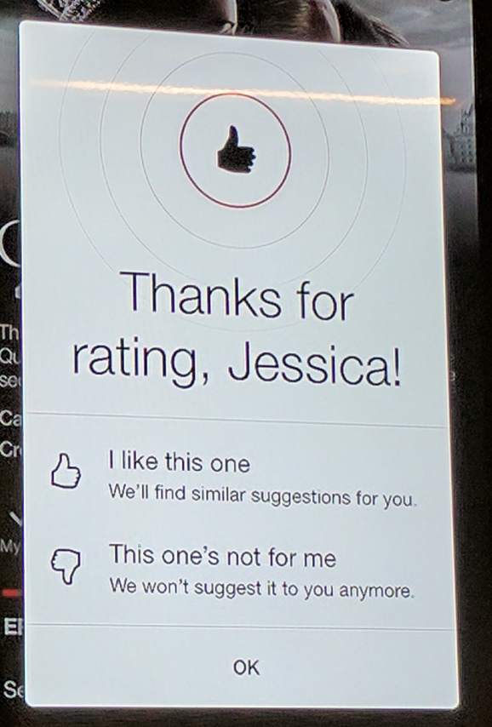
Implicit Feedback
“We made ratings less important because the implicit signal of your behavior is more important.” –Todd Yellin, Netflix VP product
Digital platform, with rich user context (how watch, when watch, which videos skip over, etc.)
1
2
Star ratings →
thumbs up
Implicit
Feedback
source: https://variety.com/2017/digital/news/netflix-thumbs-vs-stars-1202010492/

Slide 41
Business Value to Netflix
Better “take-rate”
1
Personalized
Popular
→ Better engagement
→ Lower churn
→ Higher lifetime value
→ Avoid acquisition cost
0.75
Take-Rate
0.5
0.25
0
Video Score Ranks
source: Gomez-Uribe and Hunt’15
“… [recommender systems] influence choice for about 80% of hours streamed… save[s] us more than $1 billion per year.”
– C. Gomez-Uribe VP Product Innovation, Netflix, and N. Hunt, Chief Product Officer, Netflix

Slide 43
Item Similarities

Slide 44
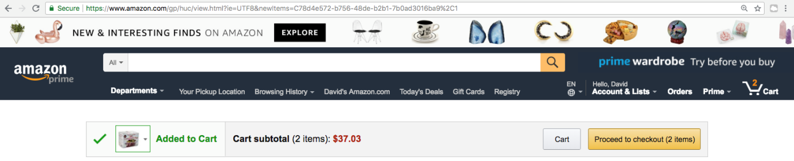
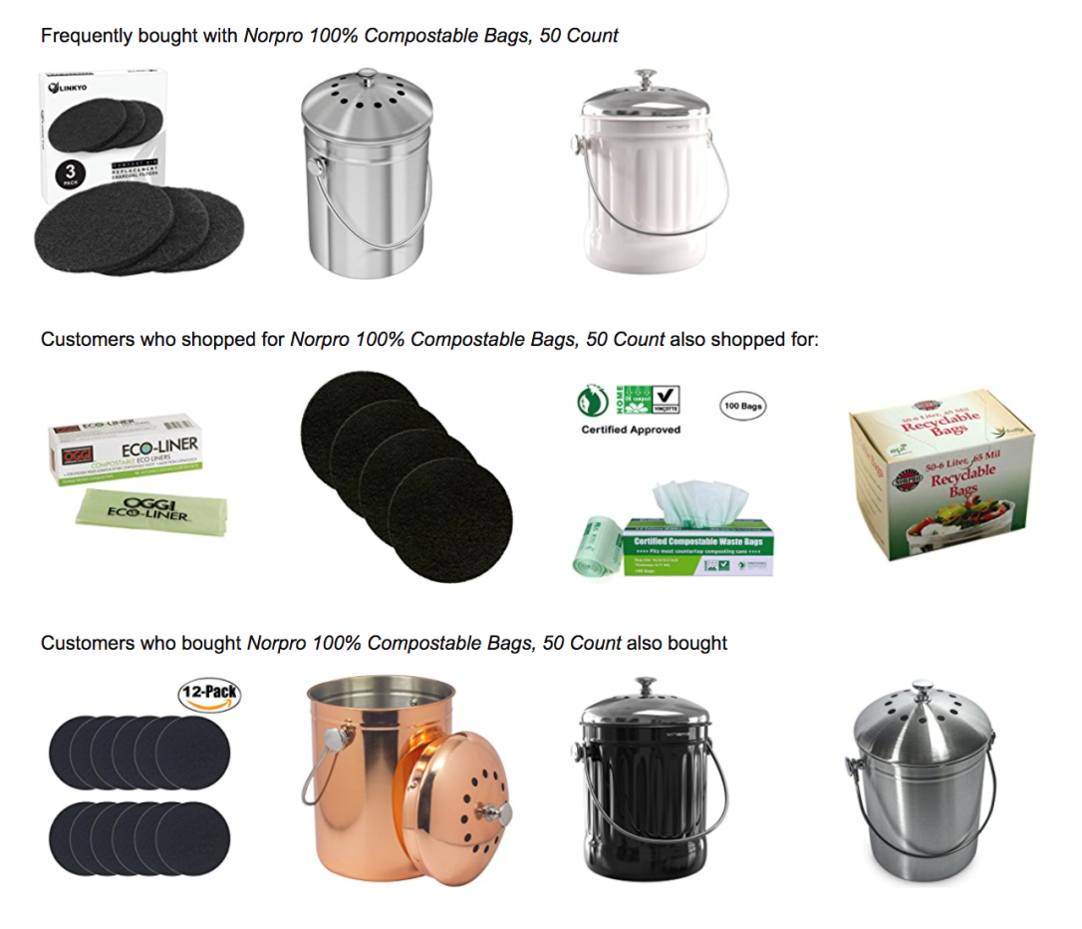
“People Who { } X Also { } Y”
“Bought with”
“Also shopped for”
“Also bought”
source: amazon.com

Slide 45
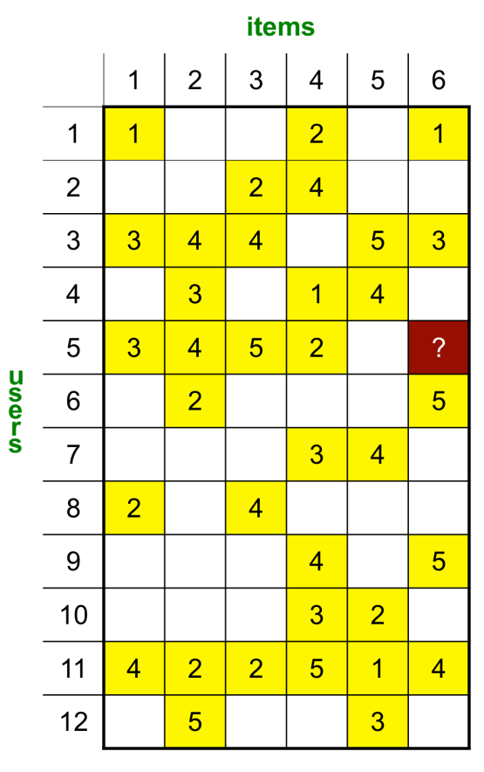
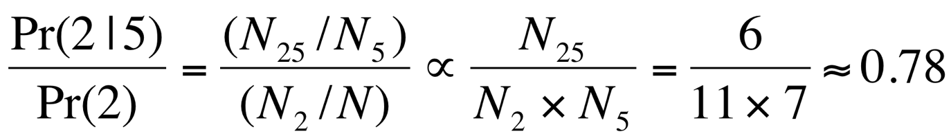
People Who Bought X also Bought Y
items
1
 | 1 | 2 | 3 | 4 | 5 | 6
1 | 5 | 5 | 4 | 3 | 3 | 4
2 | 5 | 11 | 5 | 7 | 6 | 6
3 | 4 | 5 | 5 | 3 | 2 | 3
4 | 3 | 7 | 3 | 8 | 5 | 4
5 | 3 | 6 | 2 | 5 | 7 | 2
6 | 4 | 6 | 3 | 4 | 2 | 6
2
Item 5 in basket: what to suggest?
Item 2 has highest co-occurrence
But, everyone buys item 2!
items
Co-occurrence matrix
3
Can normalize counts:
Now, item 4 is most relevant:
1 | 2 | 3 | 4 | 5 | 6
3/35 | 6/77 | 2/35 | 5/56 | X | 2/42

Slide 46
Item Similarities
Credited with 10%+ of cart-adds at Amazon
Other important considerations:
Popularity vs. relevance
Temporal factors (a dishwasher repair kit vs. a sailing manual vs. a baby rattle)
Diversity of results
Time directionality (book series)

Slide 48
Hybrid Recommender Systems

Slide 49



The Cold Start Problem
New items have no ratings
New users have no history
Content-based/hybrid methods
Additional features
User profile and contextual prameters
item | score
i1 | 0.9
i2 | 1
i3 | 0.3
… | …
Community data
Title | Genre | Actors | …
Recommendation component
Recommendation list
Product features

Slide 50
Content-Based Recommendations
Item profiles
likes
build
recommend
match
Red
Circles
Triangles
User profile
source: Mining of Massive Datasets, http://www.mmds.org

Slide 51
Tradeoffs: CF vs. Content-Based
Collaborative filtering
Content-based
☺ Simple: no feature engineering
☺ Allows people to learn from judgments of others
☹ Cold start problem for items
☺ No cold start problem for items
☺ Can provide specialized recommendations
☹ Does not leverage implicit/explicit feedback from one user to help another

Slide 52
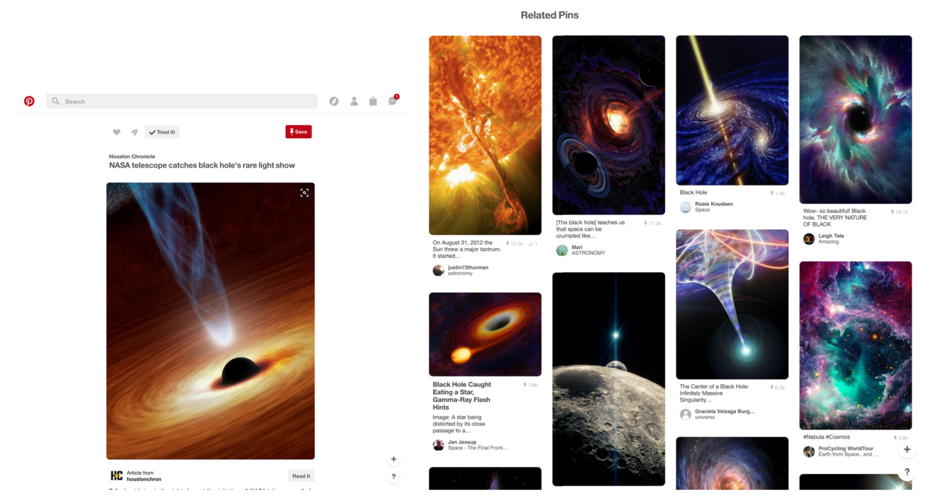
Visual Sharing on Pinterest
A social network for visually sharing, discovering new interests
Recommender powers 40% of all saves and impressions, and is one of the primary discovery mechanisms
Pin
Image
Annotation
source: Liu et al.’17

Slide 53
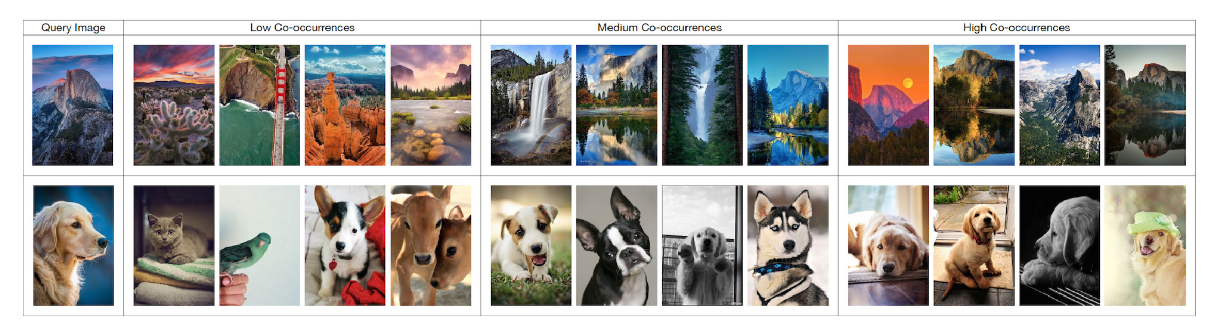
Early Version: Collaborative Filtering
Board co-occurrence: “People who saved X to a board also saved Y to the same board”
Travel,
animals
Yosemite views,
dogs
Half dome,
golden retrievers
Query
source: Liu et al.’17

Slide 54
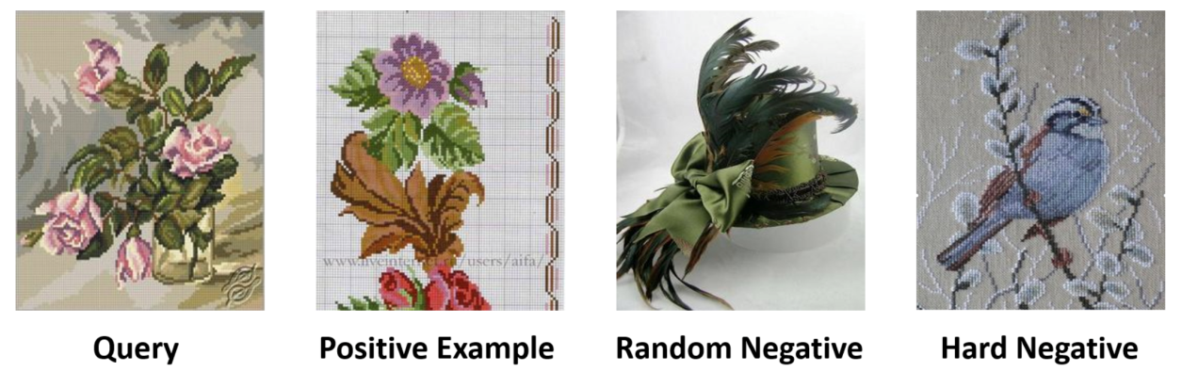
A Hybrid Recommender (PinSage)
User session: pin 1, pin 2, pin 3, …
Content (image, annotation) and co-occurrence (image and annotation of pins on same boards)
1.5 billion training pairs; use similarities to generate “hard” negative examples (similar to query):
Find 1024-dimensional embedding of pins
A/B: +20% in save action (offline vs. experimental)
source: Ying et al. ’18
© 2018 Association for Computing Machinery
Q

Slide 57
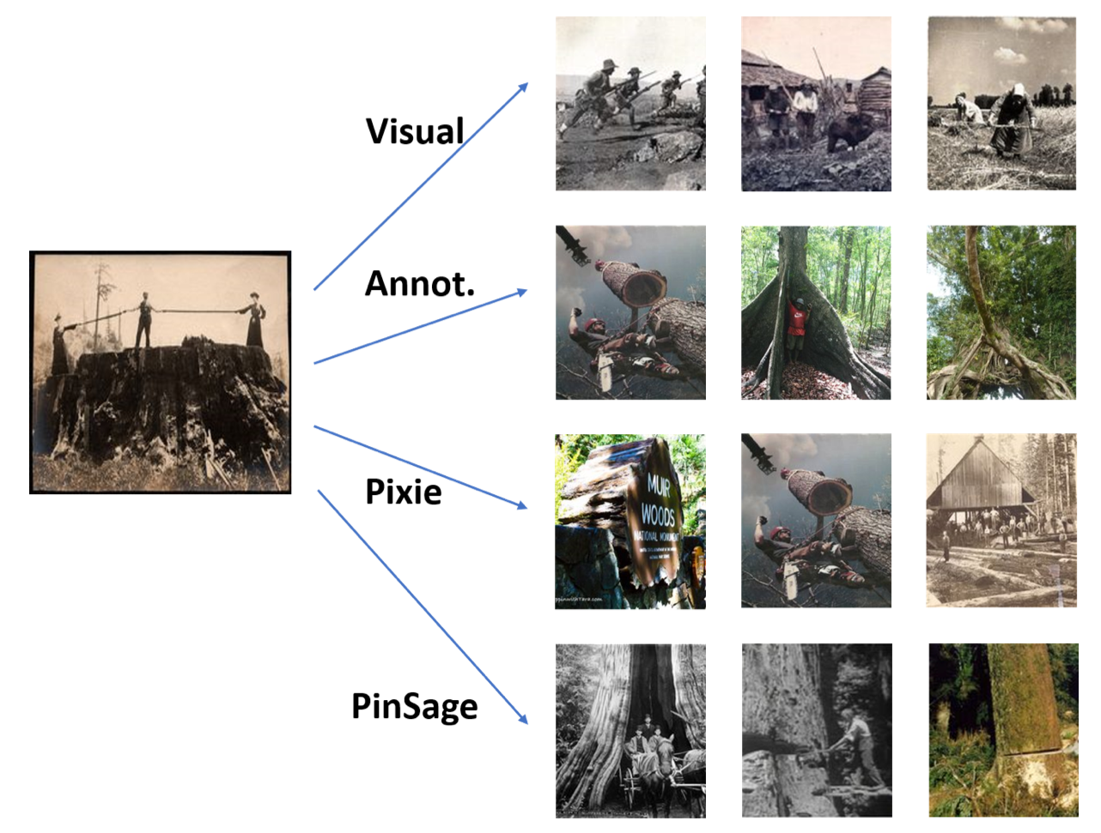
Visual and Topical Similarity
Similarities
source: Ying et al. ’18. © 2018 Association for Computing Machinery

Slide 59
Causal Effects

Slide 60
Causal Effect
Accuracy not enough (“you like Star Wars I and II, I predict you will like Star Wars III and IV”)
No surprise, no improved decision making, no incremental sales
Incrementality:
How did decisions change?
How did sales change?
How did long-term customer satisfaction change?

Slide 61
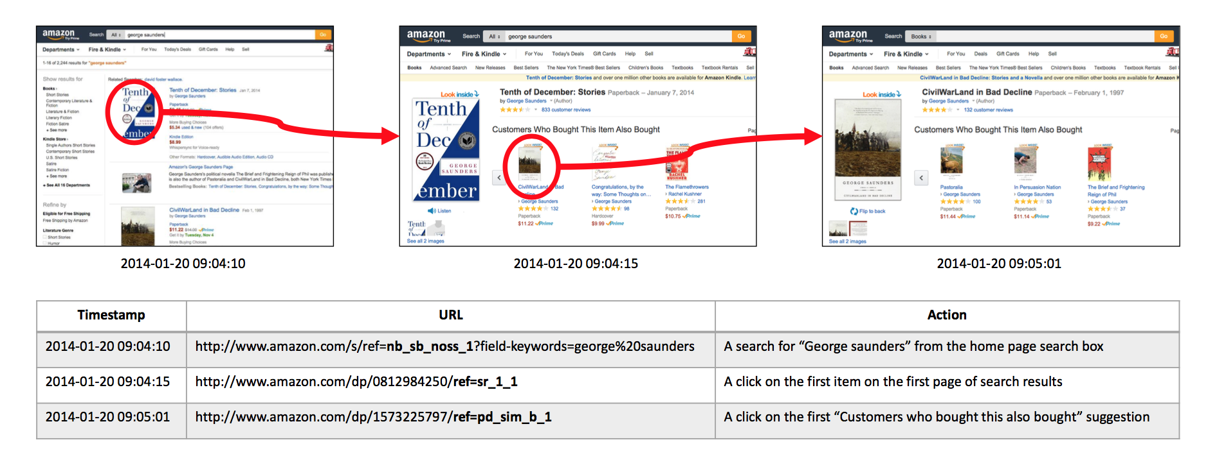
A Thought Experiment
Search
Click on first item (focal product)
Click on recommendation
How many of views of “CivilWarLand in Bad Decline” would have occurred anyway?
source: Sharma et al. ‘15

Slide 62
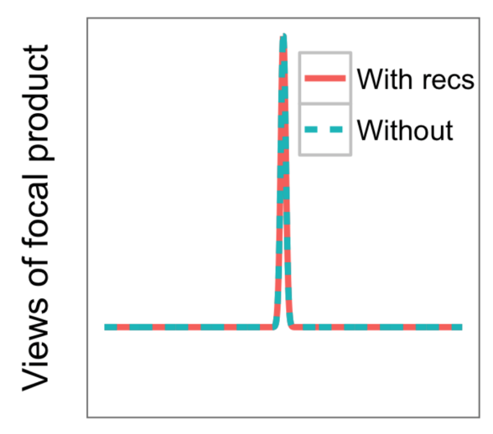
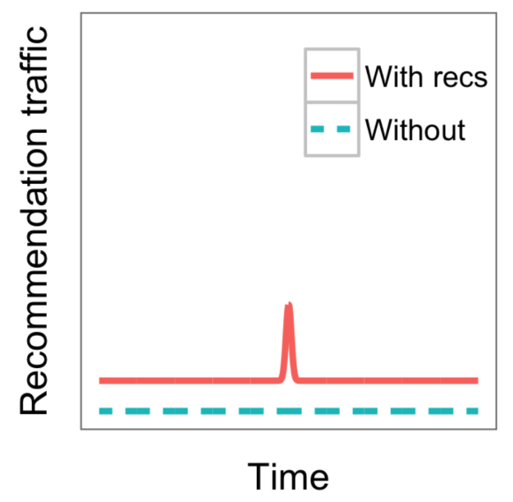
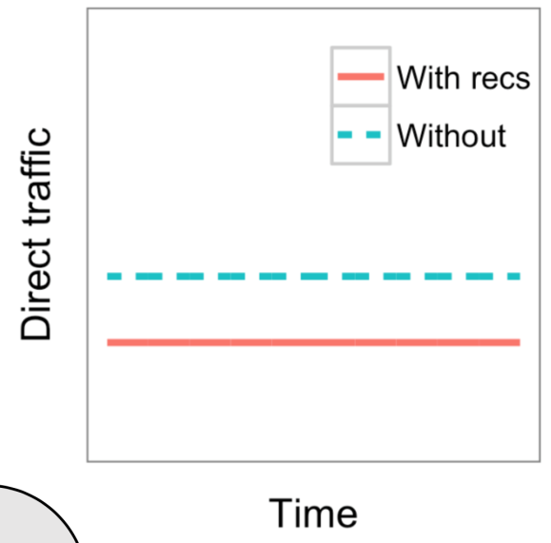


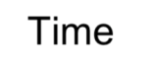
Identification Strategy
Look for “shocks” that affect “Tenth of December,” while the direct traffic to “CivilWarLand in Bad Decline” is constant
(so that demand is constant)
Tenth of December
Recommender views: CivilWarLand
Direct traffic:
CivilWarLand
Attribute traffic increase to recommender
source: Sharma et al. ‘15

Slide 63

Experimental Results
Bing browsing logs, 2.1 million users, over 9 months
4,000 products with suitable demand shocks
typical conversion rate on recommendations on shocked products is 12%
typical causal estimate (based on suitable shocks) on recommendations on shocked products is 4%
20%
Native estimate
15%
Causal upper bound
% of outbound clicks
from recommendations
10%
5%
0%
Book
eBooks
Toy
Home
Sports
Apparel
Wireless
DVD
Health and Beauty
Shoes
source: Sharma et al. ‘15

Slide 65
Broader Considerations

Slide 66
Algorithmic Marketing
Recommender systems are not neutral
Will try to optimize the key performance indicator you give them (e.g., time on site, number of clicks, number of purchases, profit)
Important to think carefully about what to optimize
Q

Slide 68
Q

Slide 69
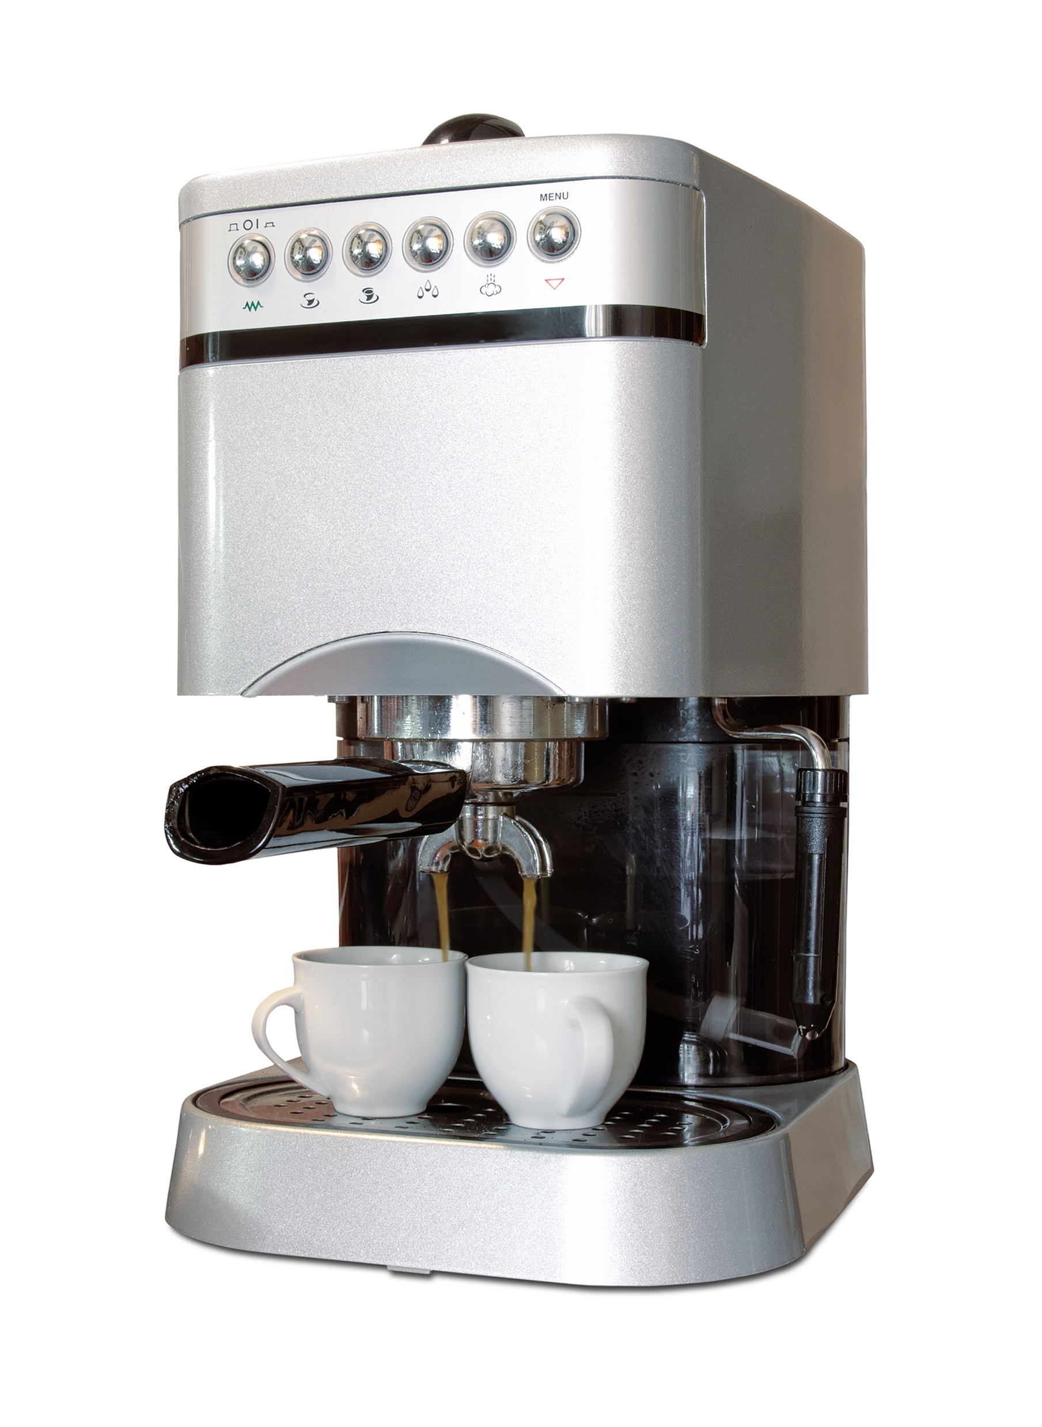
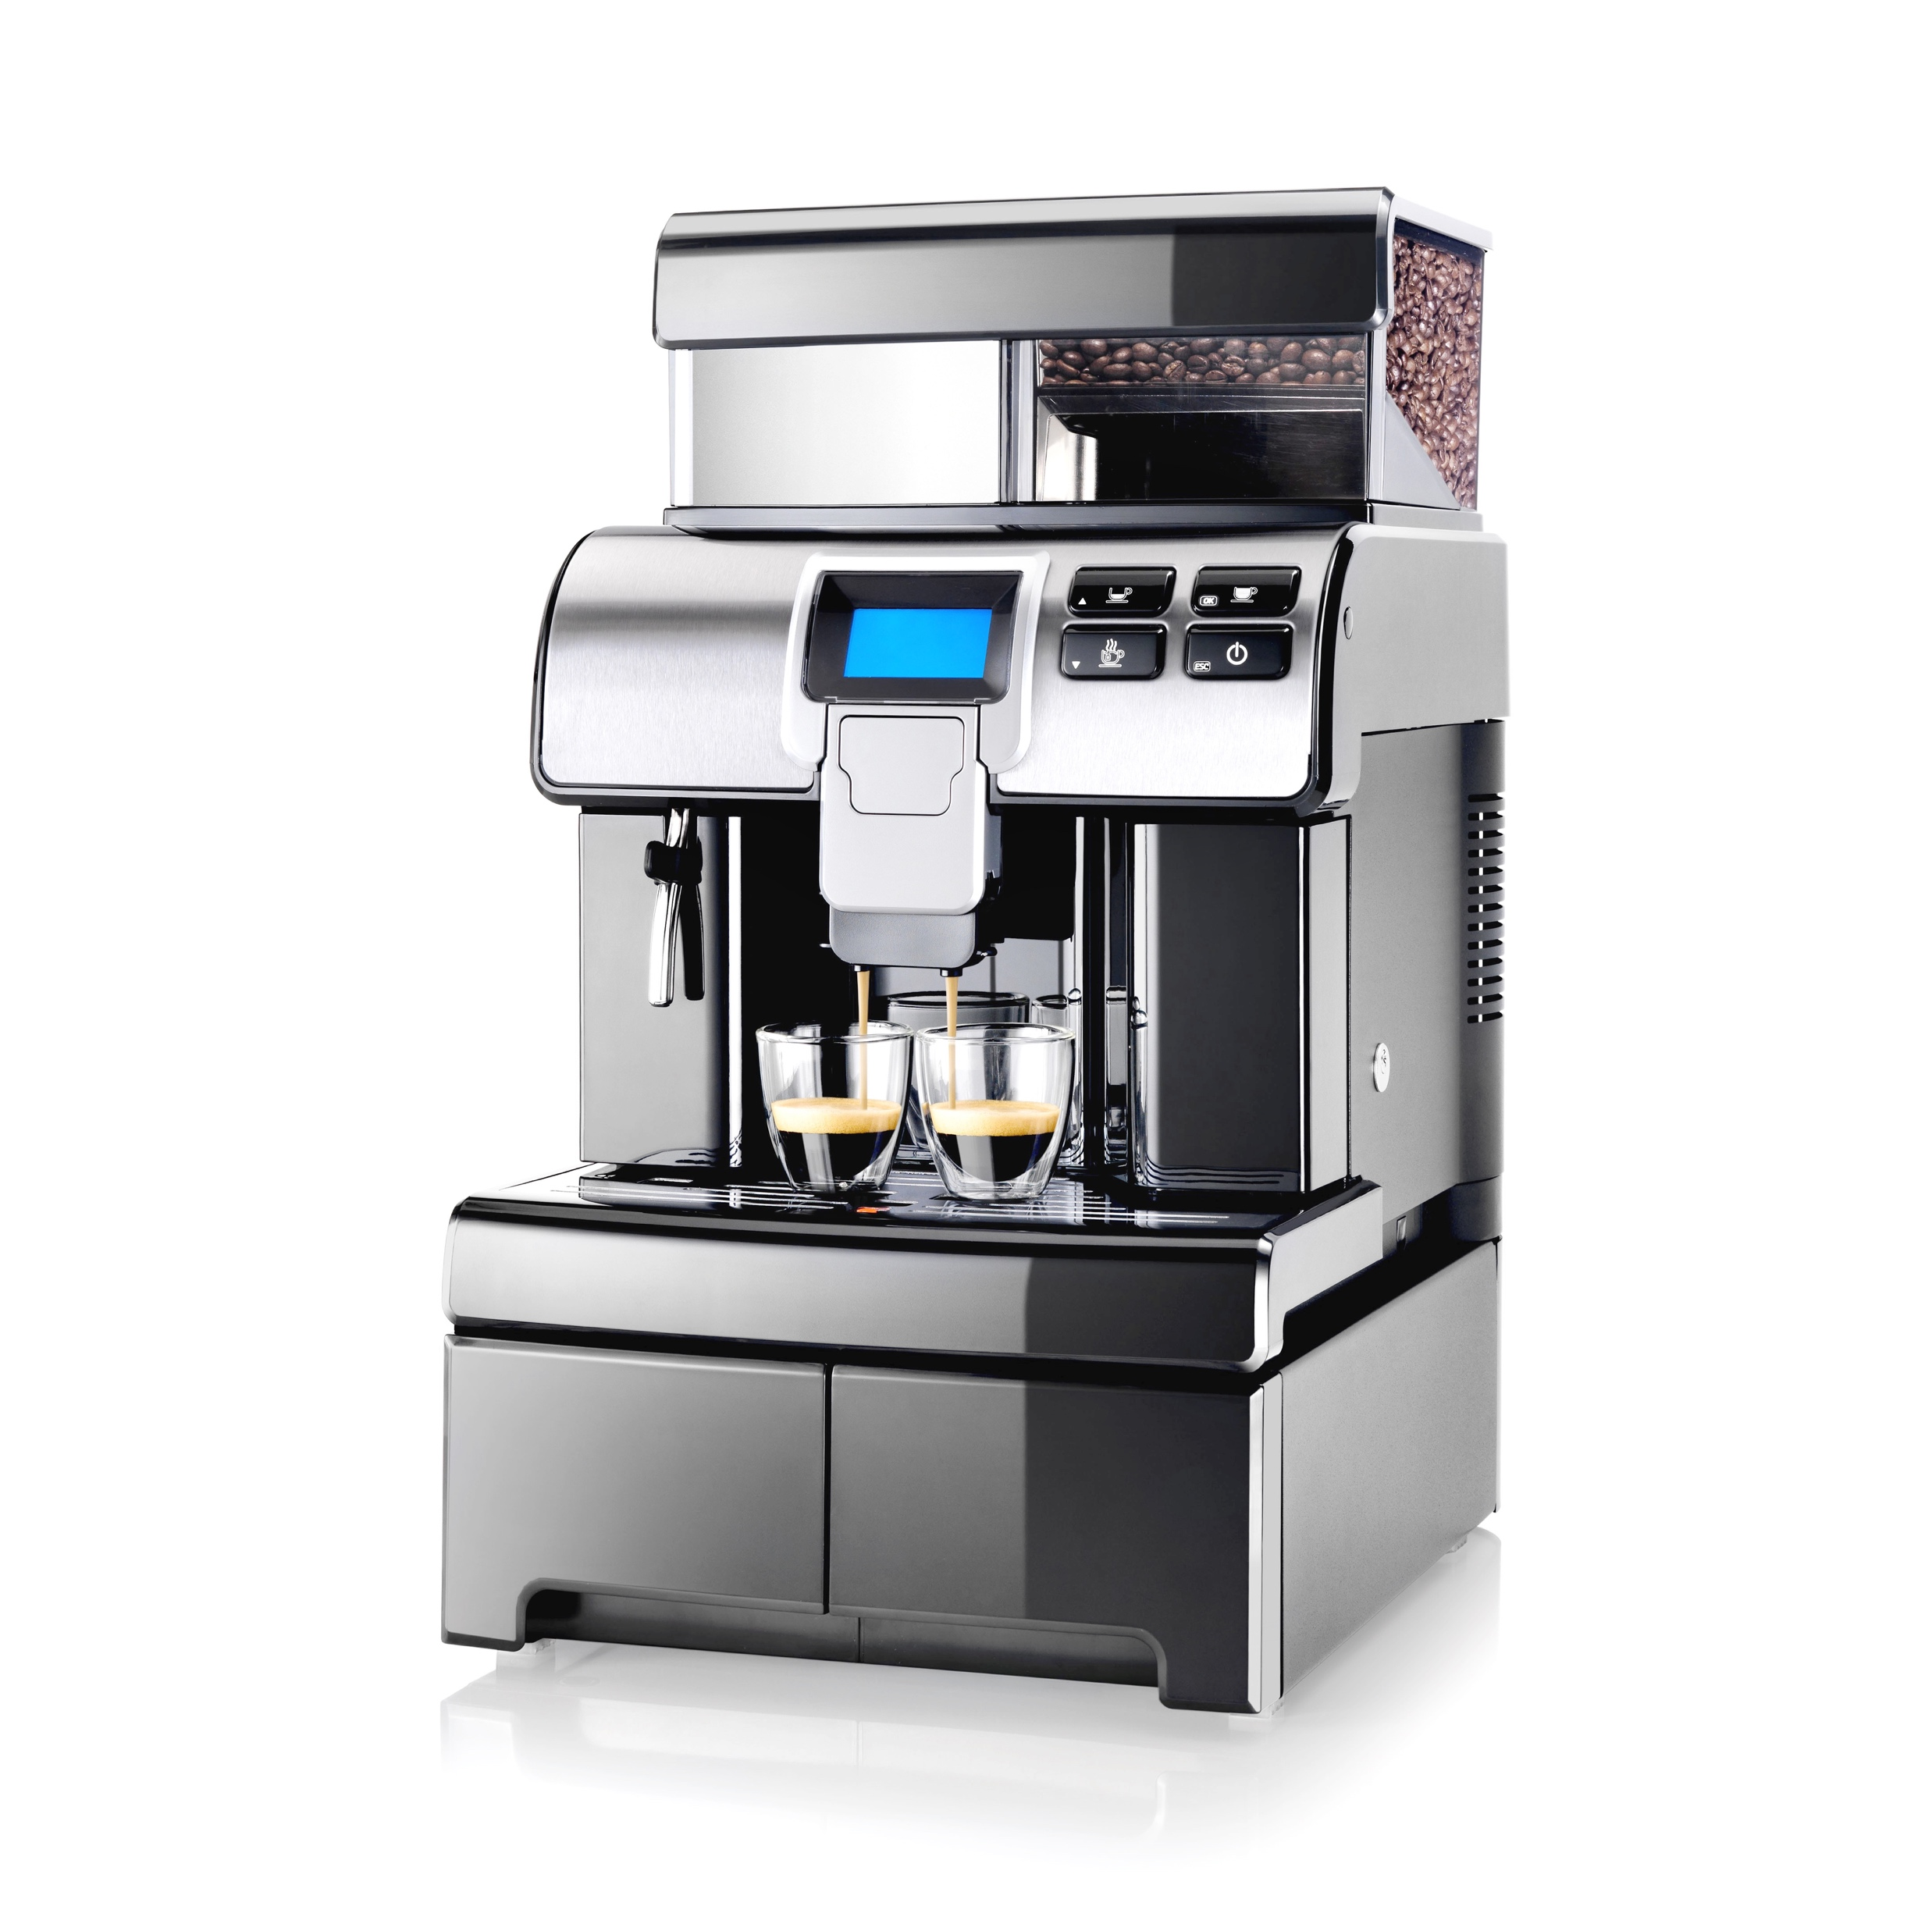
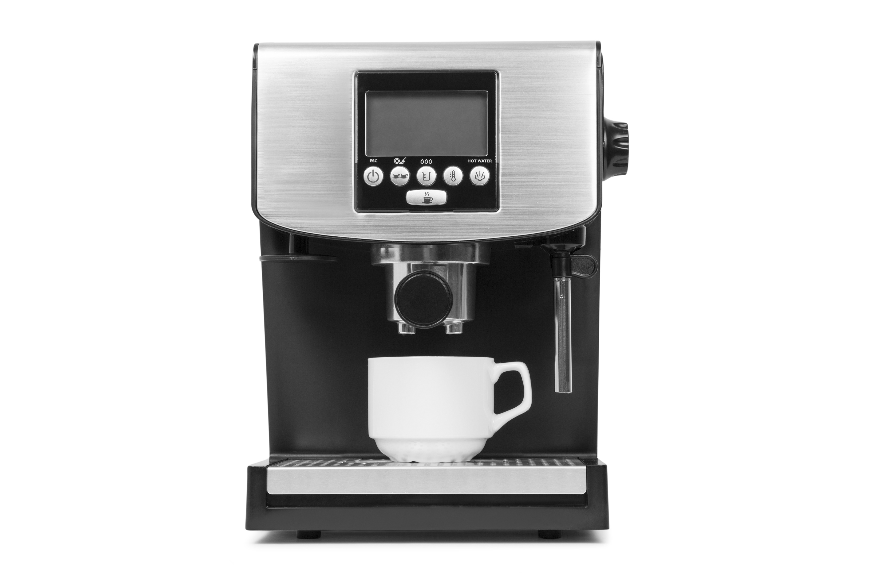
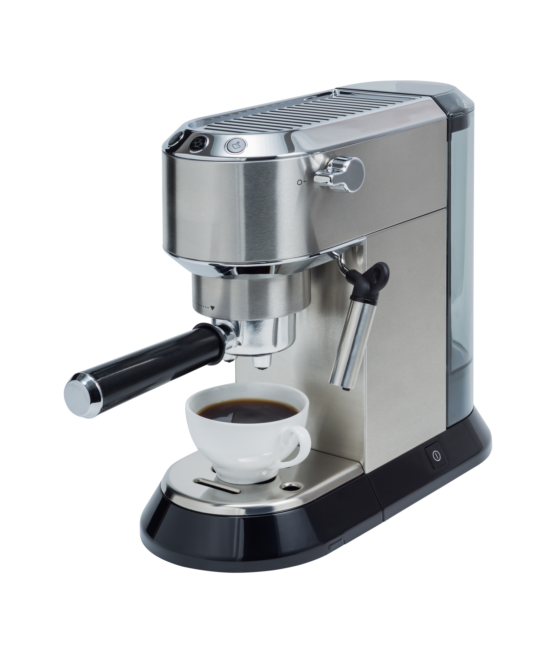
Choice Set Effects
What if your recommender system learns to present
$400
$800
$2000
…rather than
$120
$400
$800
The compromise effect—possibly good short-term profit opportunity, but what about ethics, long-term effects?
source: Amazon.com (graphics only)

Slide 70
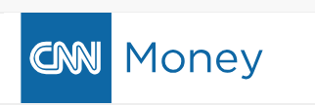
Objectives vs. Incentives
Wells Fargo dumps toxic ‘cross-selling’ metric
by Matt Egan @MattEganCNN
January 13, 2017
Need to continue to balance long-term, ethical considerations against short-term profit
Consider transparency and trust (“people who did X also did Y”)
source: http://money.cnn.com/2017/01/13/investing/wells-fargo-cross-selling-fake-accounts/index.html

Slide 71


Are You a Mac or a PC?
TECH
On Orbitz, Mac Users Steered to Pricier Hotels
On Orbitz, Mac Users See Costlier Hotel Options
By Dana Mattioli
Updated Aug. 23, 2012 6:07 PM ET
Orbitz Worldwide Inc. has found that people who use Apple Inc.'s Mac computers spend as much as 30% more a night on hotels, so the online travel agency is starting to show them different, and sometimes costlier, travel options than Windows visitors see.
source: https://www.wsj.com/articles/SB10001424052702304458604577488822667325882

Slide 72
YouTube 2008: Clicks
Recall: of the videos you have clicked on, what fraction are recommended?
Similarities: “people who view X also view Y”
16
14
Similarities
12
Responsible for 60% of clicks from home page
Two times the CTR of “top favorited,” “top rated,” “most viewed”
10
Global
Popularity
Recall (%)
8
6
4
2
Similarities (normalized)
0
1
10
Precision: of the recommendations, what fraction have you clicked on?
source: Baluja et al.’08
Q

Slide 75
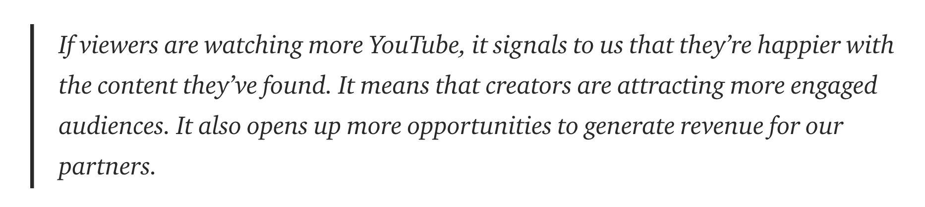
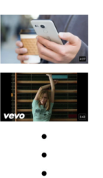
YouTube 2012+
YouTube 2012 target: will watch video completely?
YouTube 2015 target: expected watch time
Which video will user watch completely?
(256-dim embedding;
users and videos)
user history and context
Predict expected
watch time
video corpus
millions
candidate generation
hundreds
ranking
dozens
Features
… videos watched, videos searched, demographic;
impression history, time since watch this topic, video language
video features
source: https://youtube-creators.googleblog.com/2012/08/youtube-now-why-we-focus-on-watch-time.html, Covington et al.’16

Slide 76




2016 U.S. Presidential Election
Clinton search
Trump search
Trump search
source: https://medium.com/the-graph/youtubes-ai-is-neutral-towards-clicks-but-is-biased-towards-people-and-ideas-3a2f643dea9a

Slide 77
Fair Recommender Systems
Technology
Researchers Combat Gender and Racial Bias in Artificial Intelligence
Companies use AI to predict everything from the credit worthiness to preferred cancer treatment. The technology has blind spots that particularly affect women and minorities.
Initial training
Application of prediction
Historical information (with bias)
Algorithm prediction
Outcome (with bias)
Reinforcement of bias
New observations
source: https://www.bloomberg.com/news/articles/2017-12-04/researchers-combat-gender-and-racial-bias-in-artificial-intelligence
Oxera consulting, 2017

